Slide 1
Code Review Training Course. Part 4: Web Framework & Cryptography
For VIB only
namhabach@gmail.com

Slide 2
Outline
1
Web Framework
2
Web Framework Risk
3
Code Review with Web Framework
4
Cryptography in Web App

Slide 3
Web Application Framework

Slide 4
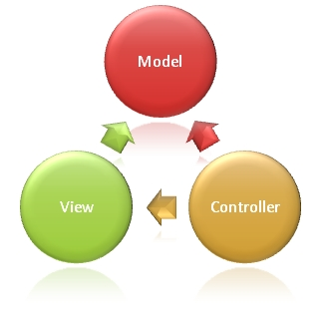
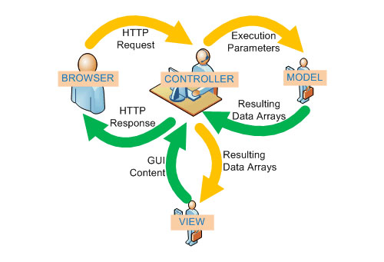
MVC Programming Model

Slide 5
Advantages
Open-source
Documentation and support
Efficiency
Security
Integration

Slide 6
& Disadvantages
Limitations
Performance
Learning bias
Steep learning curve
Cost

Slide 7




Examples of popular frameworks

Slide 8
Web Framework Risk

Slide 9
Web Framework Risk
Same as Web Application
But
Web Framework is Web Application
Risk(WF) = Risk(WA) + Risk (FW)
Risk (FW) = User Code + Framework Vulnerabilities + Implement

Slide 10
Code Review with Web Framework

Slide 11
Code Review with Web Framework
Same as Web Application Code Review
Code Review
Mapping
Entry Point/End Point
More:
Review Framework Security
Review Third-party Security

Slide 12
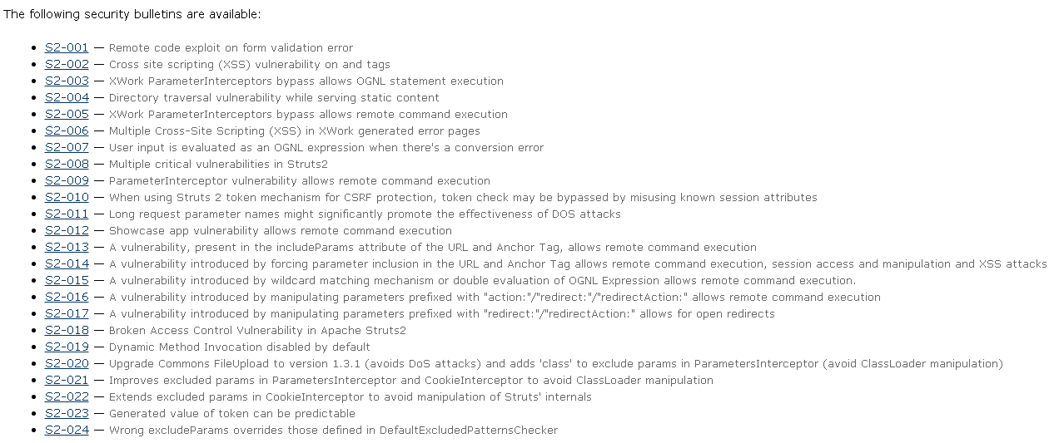
Review Framework Security
Review Vulnerabilities of Framework

Slide 13
Review Framework Security
Review Framework Feature
Remove Example
Remove Unusable component
Enable Security Feature
Security Coding
Use Framework API.
Ex: Doctrine, Active Record
Use Framework Parsing: Input and Output
Use Framework Filter

Slide 14
Cryptography in Web App

Slide 15
Cryptography in Web App
Incorrect Hash Signature
Length-Extension Attack
And:
Oracle Padding
BEAST
POODLE
….
Not include here

Slide 16
Incorrect Hash Signature
Website have: Merchant code & Shared secret key
Signature generate:
1. Order parameter (ABC)
2. Add Secret key
3. Calculate hash: MD5, SHA1
4. Sent to Payment gateway like Signature

Slide 17
Incorrect Hash Signature
1. order_id=123, merchant_id=1230, amount=100000 → amount=100000, merchant_id=1230, order_id=123
2. SECRET1000001230123
3. MD5(SECRET1000001230123)
signature=7BD70B91F6F026FBFFFA552A7D59B5BD

Slide 18
Incorrect Hash Signature

Slide 19
Incorrect Hash Signature
Not separate character ( | )
Focus string generate to make signature
Must use separate character
MD5 → length-extension attack
Don`t use MD5
Use HMAC

Slide 20
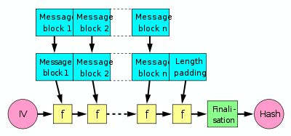
Length-Extension Attack

Slide 21
Length-Extension Attack
signature1 = MD5(SECRET||m)
signature2 = MD5(SECRET||m||p||x)
response1 = “amount=100000&merchant_id=1230&order_id=567&signature=[sig1]”
m1 = “1000001230567"
sig1 = MD5(SECRET || m1)
x = 10000056701156
m2 = m1 || p1 || x
sig2 = MD5(SECRET || m2)
response2 = “aaa=[m1||p1]&amount=100000&order_id=567&status=0&tranx_id=1156”

Slide 22
Questions?

Slide 23
#Enter to next part_>
End of Part 3

